Slide 1



Bias and truth in science evaluation: a simulation model of grant review panel discussions
Adrián Martín Bethencourt, Junwen Luo, Thomas Feliciani
ROMCIR Workshop. April 2021

Slide 2
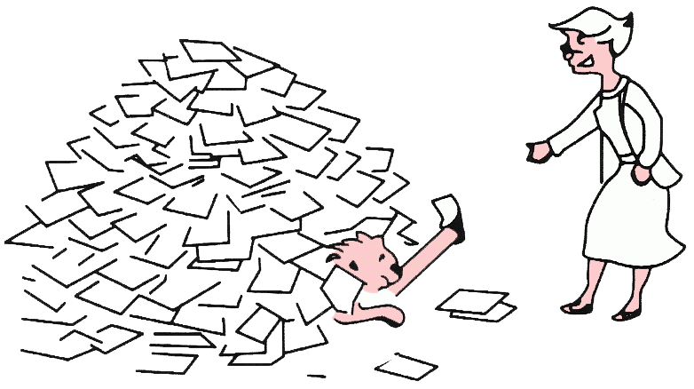

Introduction
Information retrieval
Peer review

Slide 3


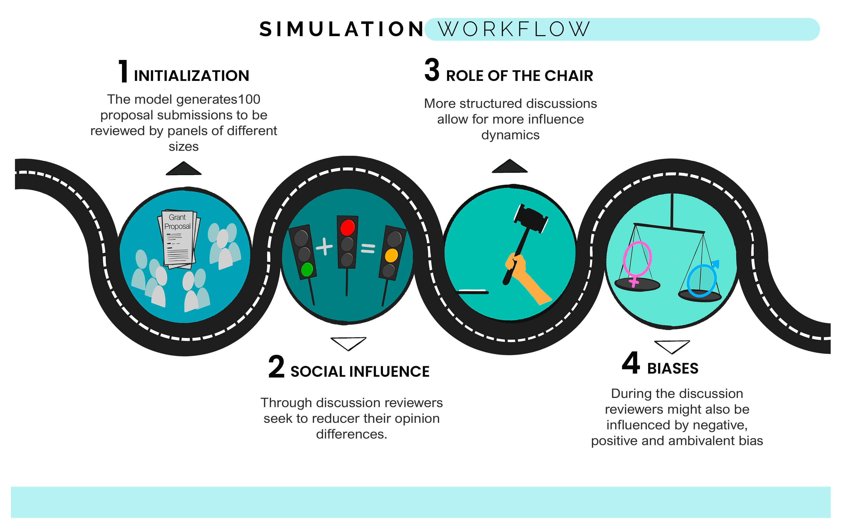
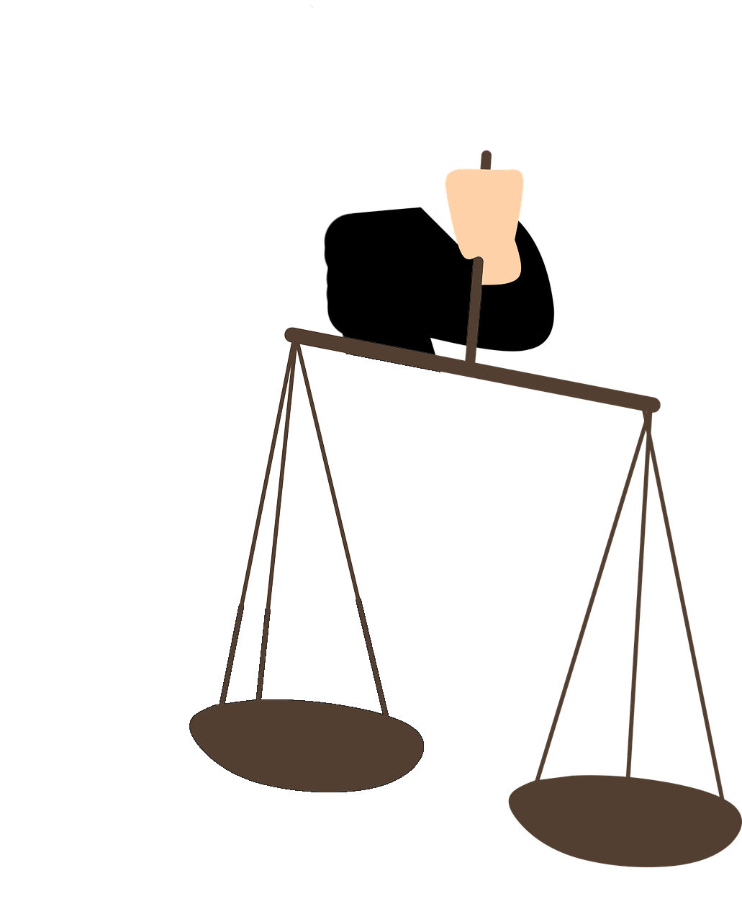

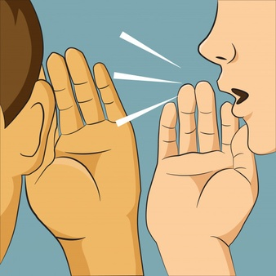
Introduction
Peer review
Evaluation Criteria
Reviewers Biases
Social Influence Dynamics

Slide 4
Table of content
Bias in peer review and evaluation criteria
Social influence dynamics
Methods
Results
Conclusion and limitations

Slide 5



Typical peer review process at a Research Funding Agency
Evaluation stages
Evaluation criterion
1- Postal review
2- Panel discussion
Applicant
Research Programme
Potential for Impact
Final scores

Slide 6
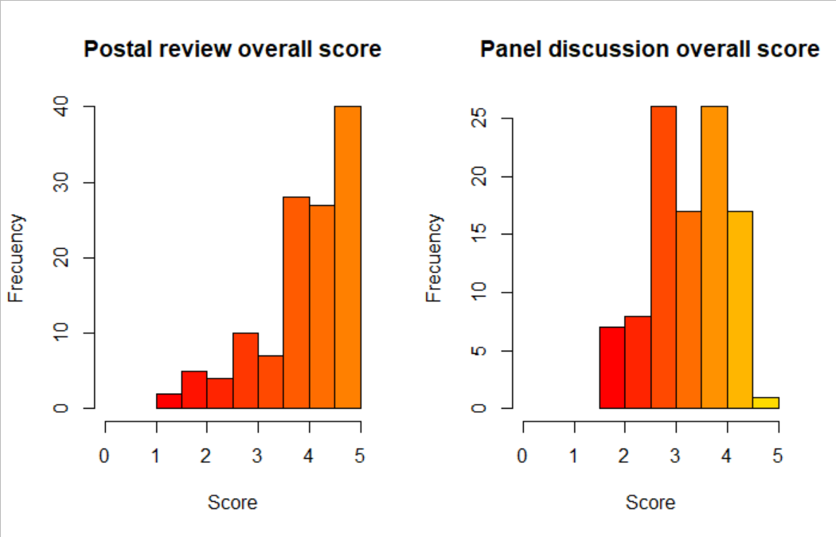
The black box problem
Stage 1. Pre-discussion score distribution
Stage 2. Post-discussion score distribution
Reproducing the distribution of review scores with an ABM.
The aim of the investigation is to make use of the individual scores at the postal review stage (left) to reproduce the observed distribution after the panel discussion (right)
BLACK-BOX

Slide 7
Bias in peer review
Negative
Gender bias: make women to receive more severe than fair evaluation of submissions.
Biases
Positive
Old-Boysm: older researchers are expected to be more expertise, thus, they tend to recieve more positive than fair evaluation
Ambivalent
Conservativism: novel proposal can either be positevely or negavitely trated depending on multiple conditions

Slide 8


Social influence dynamics
Assimilative influence
Panel chair role
Structured
Unstructured
Minimize the individual disagreement towards others by been influenced by the group

Slide 9
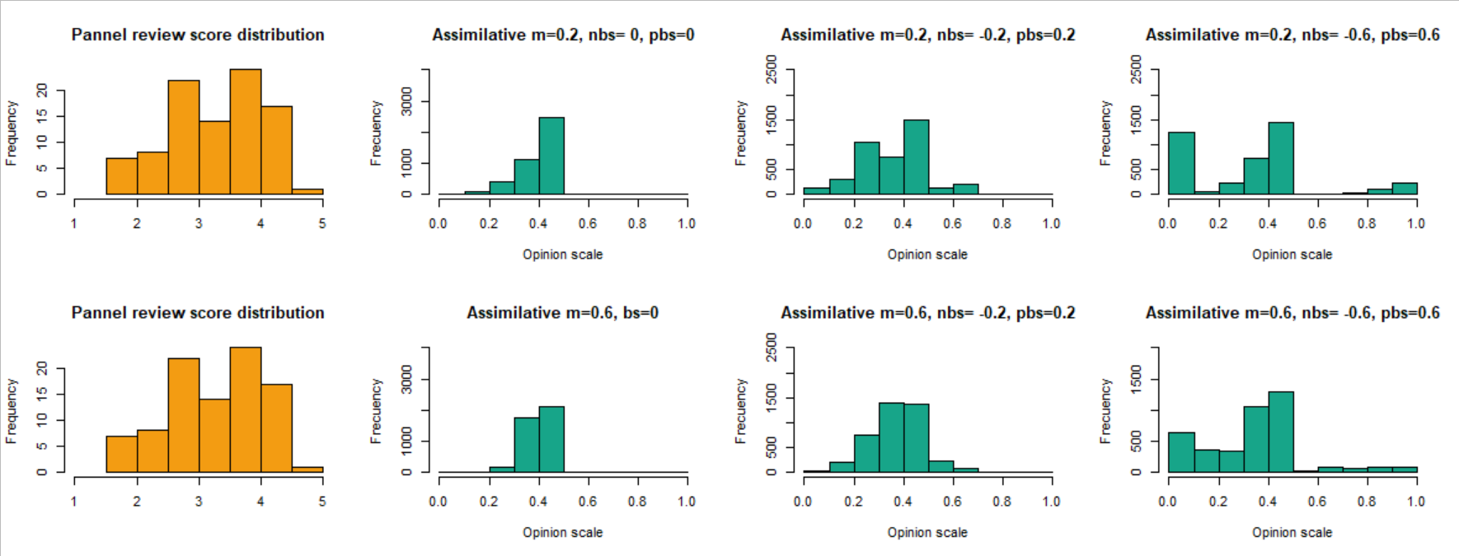
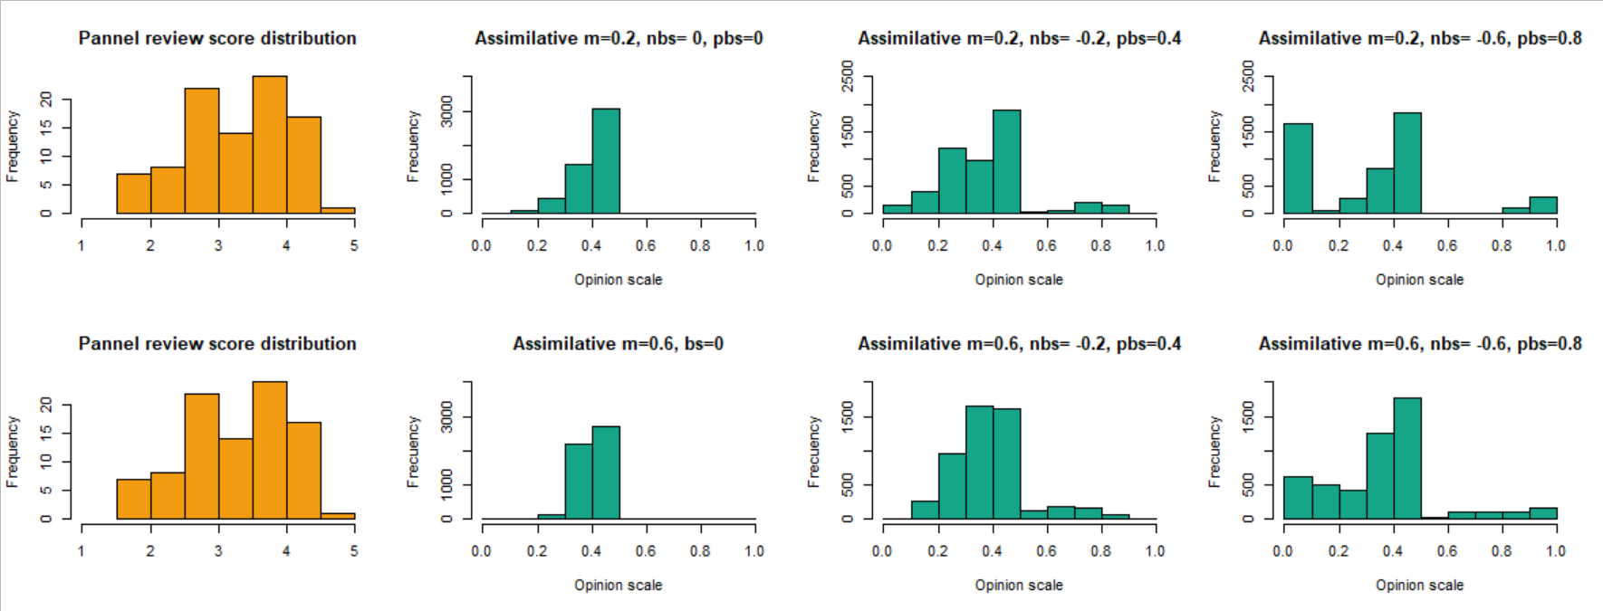
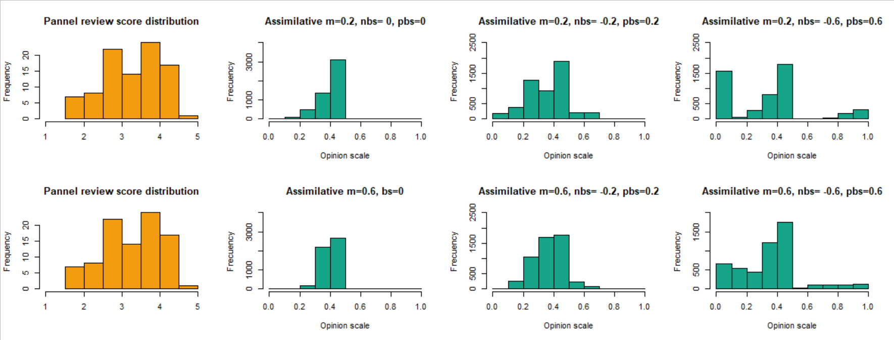
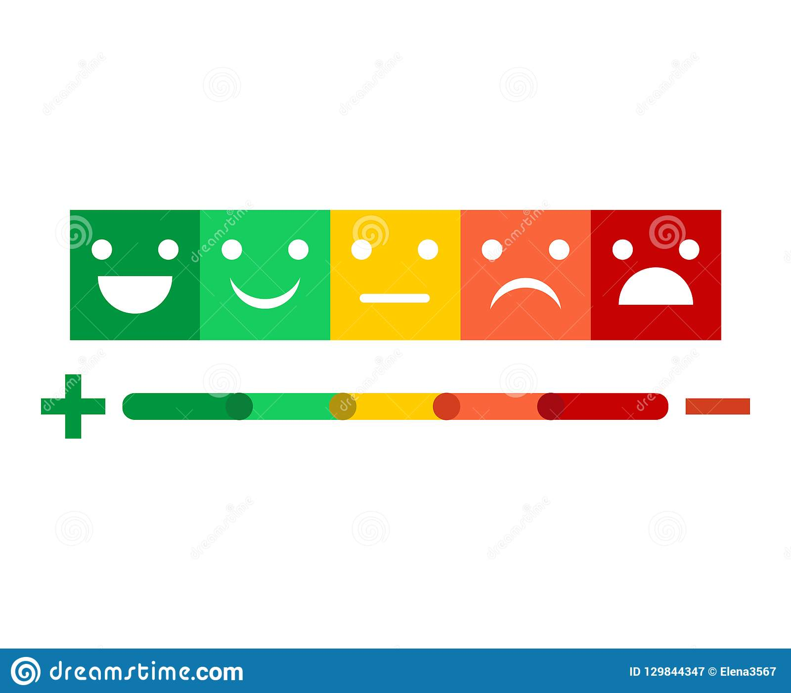
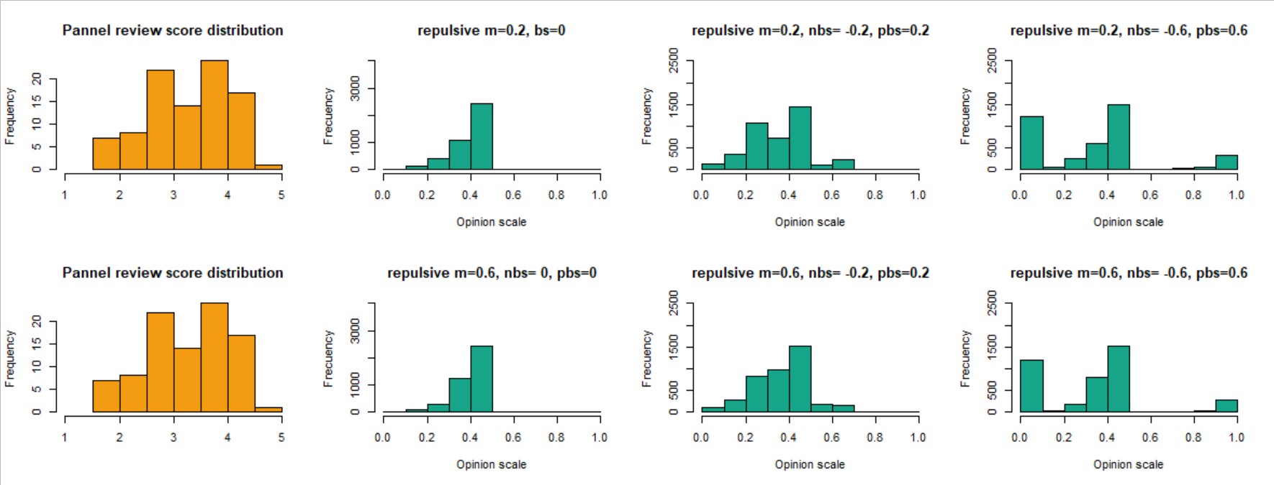
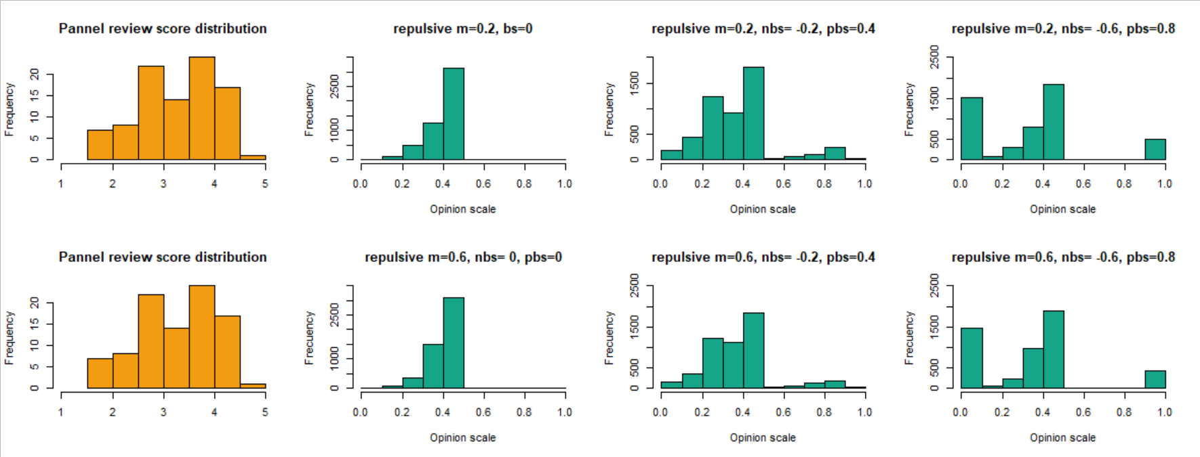
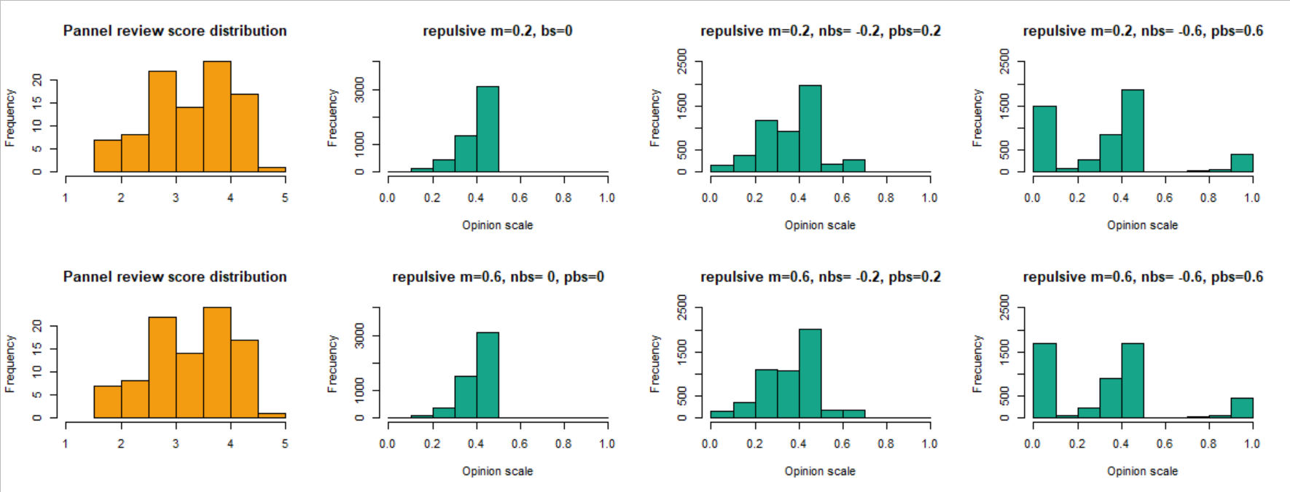
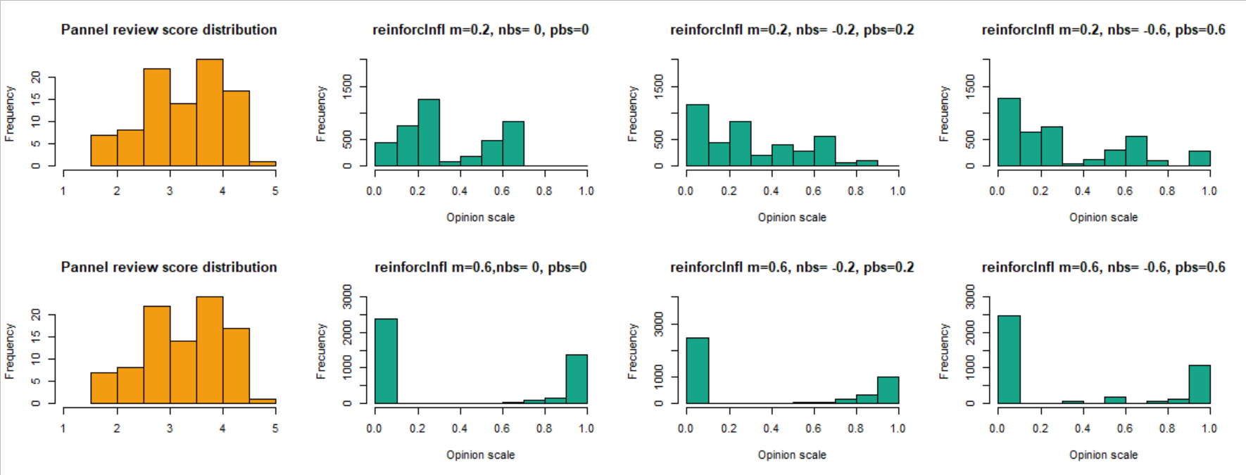
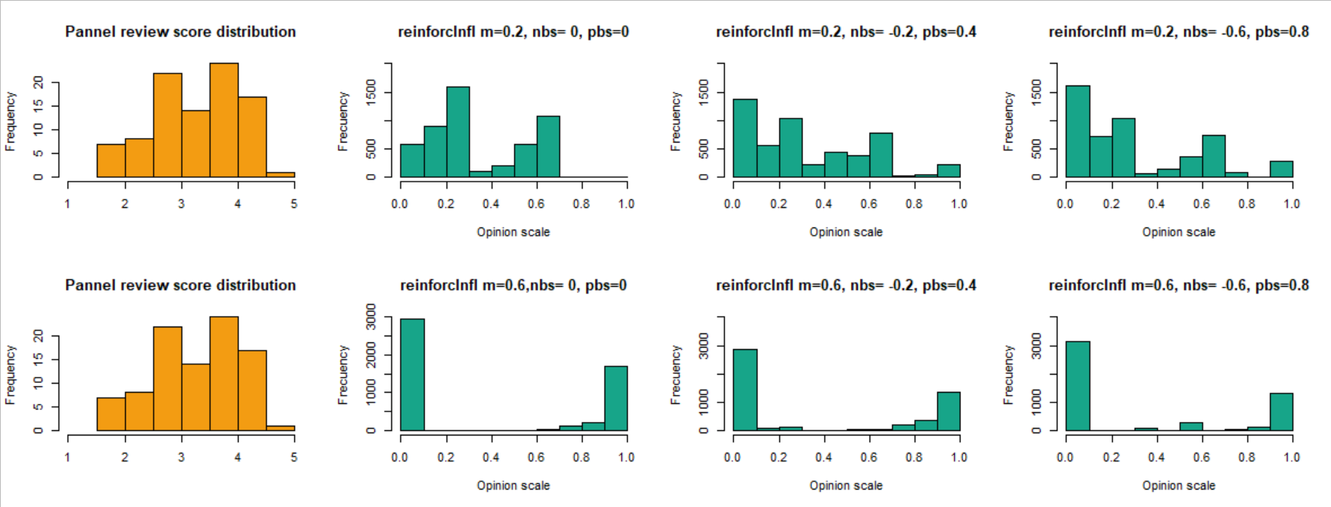
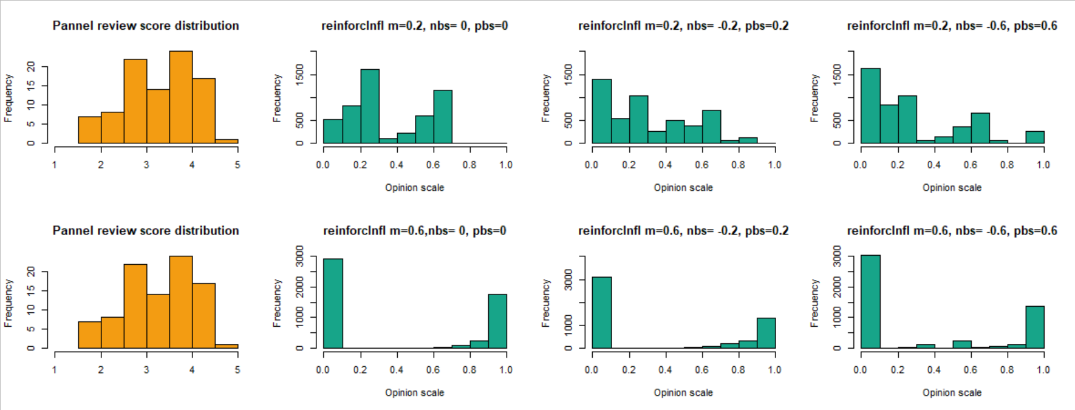
Methods
Social simulation
(Agent Based Modelling)
Qualitative coding
Similarity Index
?

Slide 10

Qualitative coding
Qualitative coding of reviews as proxis of reviewer opinions scores
Comments on the sections
Very positive
Moderate positive
Neutral
Moderate negative
Very negative
5
4
3
2
1

Slide 11
Agent-based model

Slide 12
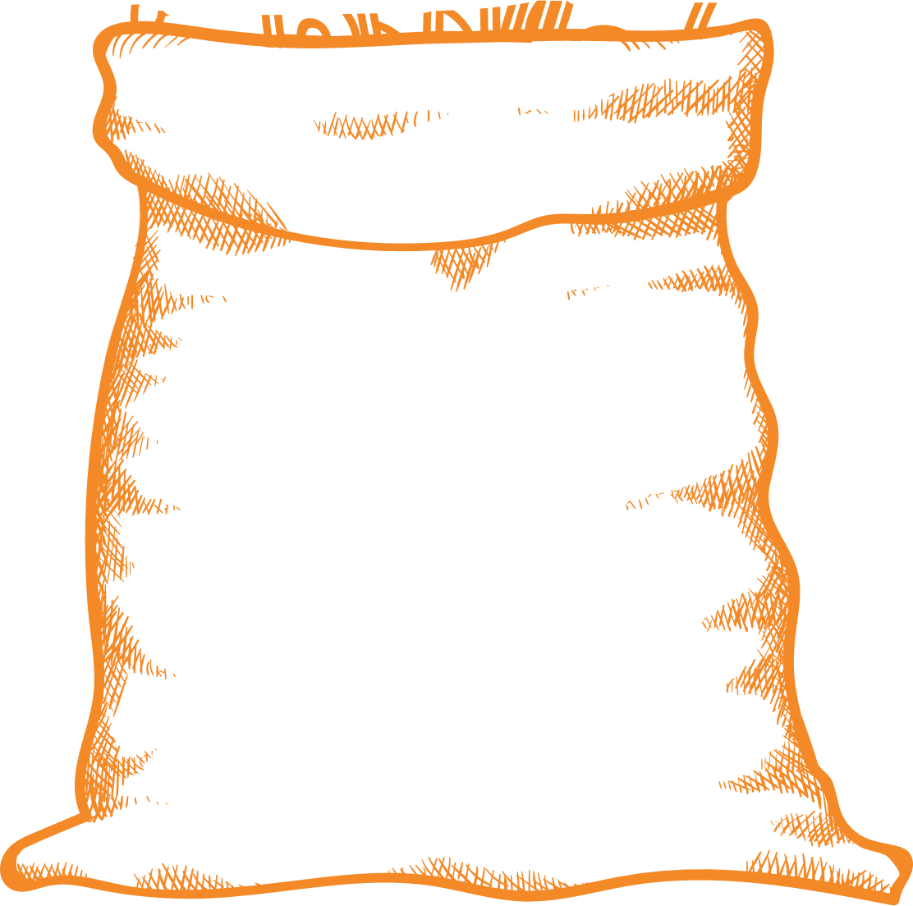
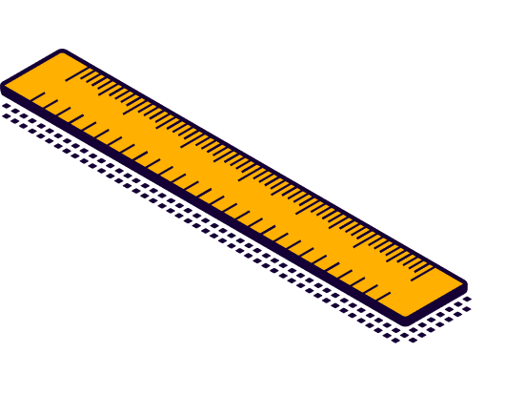


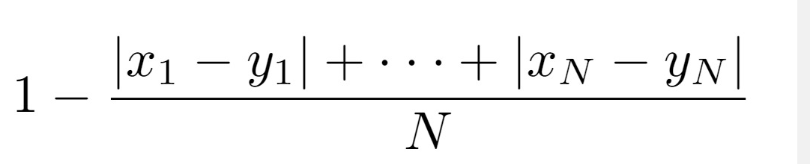
Similarity Index
1- All opinions go into one bag
Which parameter configuration(s) produce opinion distributions more similar to the empirical distributions at the end of panel discussions?
1
2- Opinions are discretized
5
3- We calculate the expected distribution (relative frequency) of each grade in the bag
4- Similarity =
1 - Absolute diference between the expected and the empirical distributions.

Slide 13
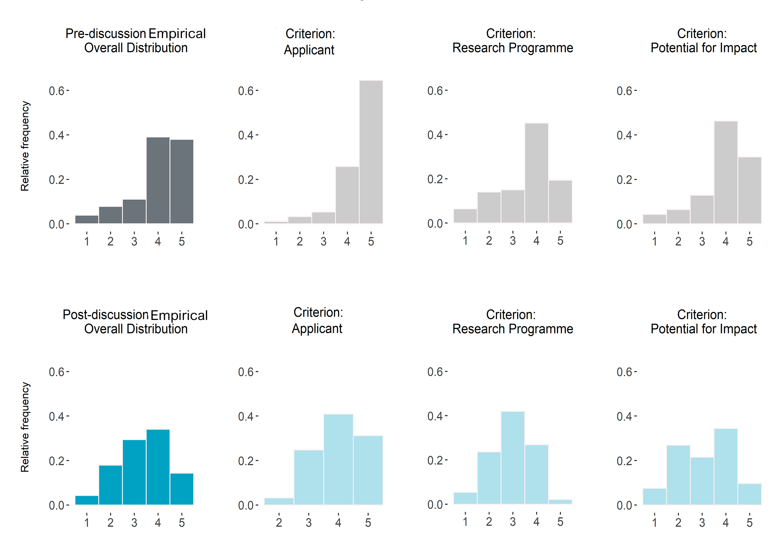
Results
Positive correlation between stages (P-value < 0.01)
Discussion leads to bell-shaped distributions

Slide 14
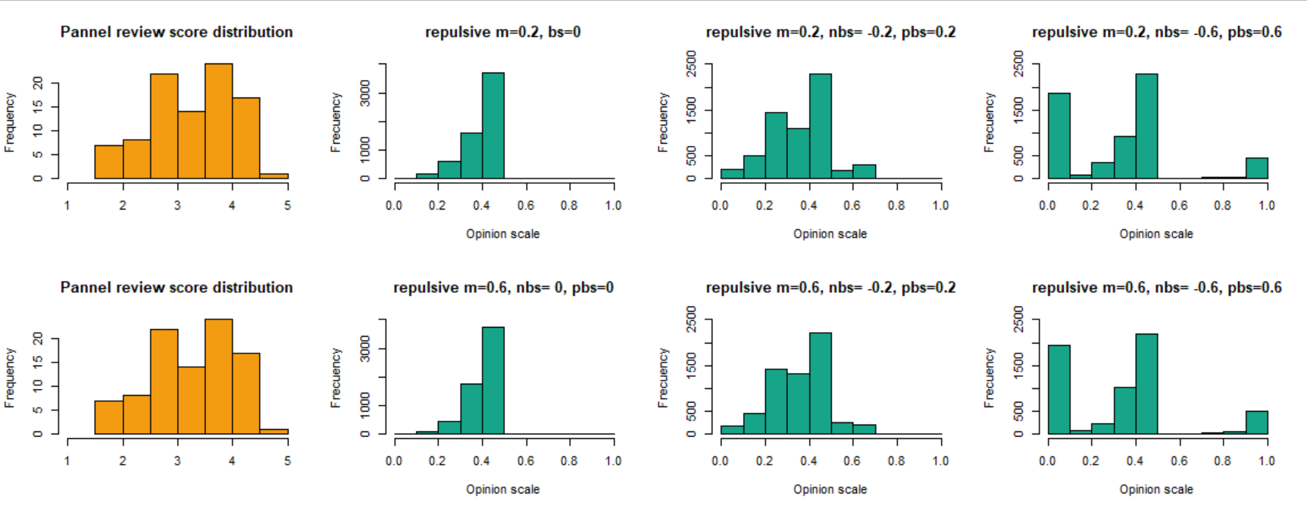
Conclusions
Reinforcing influence
Unbalanced influence
Assimilative influence
?
Repulsive influence
Repulsive influence
Reinforcing influence
Reinforcing influence
Repulsive influence
Repulsive influence
Panel composition: 5 reviewers
Balanced influence
Assimilative influence
Reinforcing influence

Slide 15
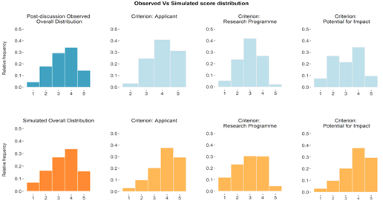
Results
N = 5; ρ = 0.05; ε = 0.025 (positive bias) and -0.1 (negative bias); probability = 0.25 (positive bias) and 0.25 (negative bias).
Similarity index = opinion range 0.95-0.67

Slide 16
Results
N = 5; ρ = 0.05; ε = 0.025 (positive bias) and -0.1 (negative bias); probability = 0.25 (positive bias) and 0.25 (negative bias).
Similarity index = opinion range 0.95-0.67
Potential for impact: higher difference

Slide 17
RESULTS
Number of reviewers(N)
Panel chair
Biases
Negative
Positive

Slide 18
Results by sections
Research
Programme
Strong panel chair
Applicant
Negative bias
Potential for Impact
≤ 0.98
≤ 0.98
≤ 0.95

Slide 19
Conclusions
Assimilative dynamics (consensus-oriented, disagreement-reducing panel discussions) and some degree of negative bias against some proposals were compatible with the empirical opinion changes.
The distributions of reviewer opinions after panel discussions differed between criteria:
Simulations were worse at reproducing the discussion about the potential for impact.
Different criteria are best matched by different kinds of biases.

Slide 20
Limitations
Agents Demographic characteristics
Hibrid models
Limited parameter space
Data limitations
We have examined the effects of only one type of influence dynamics (assimilative influence).
More realistically, multiple kinds of social influence dynamics might be at play in real-world panel discussions
Other combinations of biases and conditions might perform even better at replicating the empirical opinion changes in review panels.
Our calibration data data was based on one research funding scheme provided by one research funding agency (Science Foundation Ireland) - ideally, our results need to be validated by
- Using data from other funding schemes
- Using a different operationalization of reviewer opinions.
While our work has highlighted a possible link between evaluation criteria and types of bias, we have not considered the role of agents’ demographic characteristics in the evaluation process.

Slide 21

Acknowledgment
Contact me: Adrian.martinbethencourt@ucdconnect.ie

Slide 22
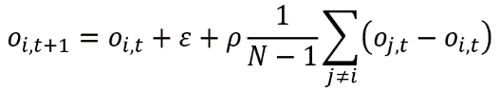
Agent-based model
Table 1. Parameter space overview.
Table 2. Biases: examples and parameterization.
Assimilative Influence Dynamics

